Slide 1
BBM384 Software Engineering Laboratory
Week 10 & 11
T.A. Burcu YALÇINER
Spring, 2018

Slide 2
UML MODELLING
(Statechart, Class, Sequence Diagrams)

Slide 3
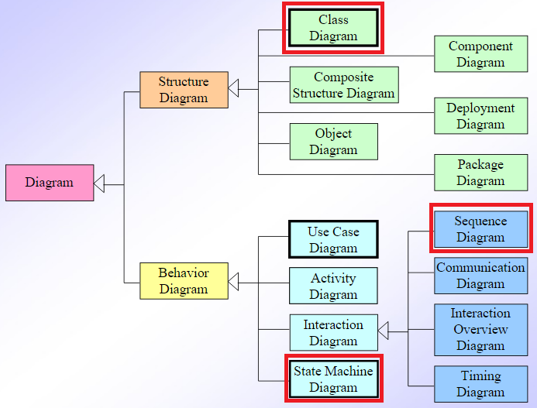
UML DIAGRAMS

Slide 4
STATECHART DIAGRAM
Any real time system is expected to be reacted by some kind of internal/external events. These events are responsible for state change of the system. Statechart diagram is used to represent the event driven state change of a system. It basically describes the state change of a class, interface etc. Statechart diagram is used to visualize the reaction of a system by internal/external factors.
The main usage can be described as
To model the object states of a system.
To model the reactive system. Reactive system consists of reactive objects.
To identify the events responsible for state changes.
Forward and reverse engineering.

Slide 5
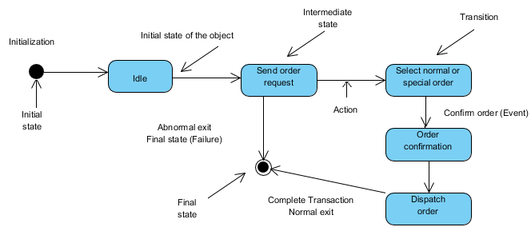
STATECHART DIAGRAM
Before drawing a Statechart diagram we should clarify the following points
Identify the important objects to be analyzed.
Identify the states.
Identify the events.
Following is an example of a Statechart diagram where the state of Order object is analyzed
https://www.tutorialspoint.com/uml/uml_statechart_diagram.htm

Slide 6
Draw the statechart diagram for HMS

Slide 7
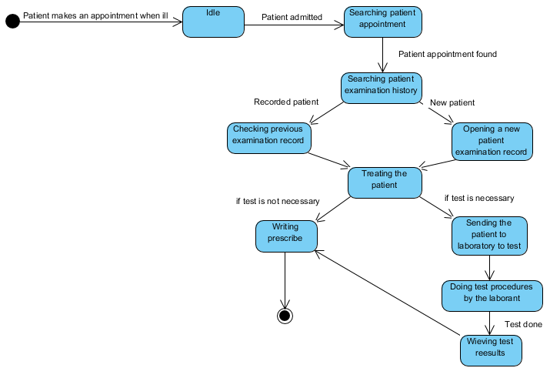
STATECHART DIAGRAM FOR HMS

Slide 8
CLASS DIAGRAM
A static diagram
Used for describing structure and behavior in the use cases
Provide a conceptual model of the system in terms of entities and their relationships
Class is represented with boxes which contain three parts:
Name
Attributes
Operations
Modifiers are used to indicate visibility of attributes and operations
‘+’ →Public visibility (everyone)
‘-’ → Private visibility ( no one)
‘#’ → Protected visibility (friends and derived)
The top part contains the name of the class. It is printed in BOLD, centered and the first letter capitalized.
The middle part contains the attributes of the class. They are left aligned and the first letter is lowercase.
The bottom part gives the methods or operations the class can take or undertake. They are also left aligned and the first letter is lowercase
By default, attributes are hidden and operations are visible.
You may omit the last two compartments to simplify the class diagrams

Slide 9
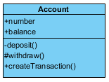
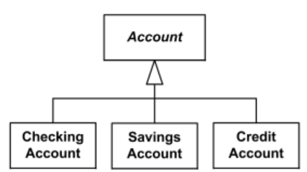


CLASS DIAGRAM
An example of class
There are two kinds of Relationships
Generalization
A parent/child relationship among related classes
Used for abstracting details in several layers
Association
Relationships between instances of classes
A link connecting two classes
There are two types of association:
Bi-directional association
Uni-directional association
It can be further classified as:
Aggregation
Composition
Name
Attributes
Operations
In bidirectional association, two objects are related and both objects know about the relation.
In unidirectional association, two objects are related but only one object know about the relation.

Slide 10
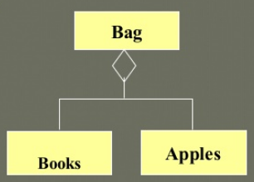

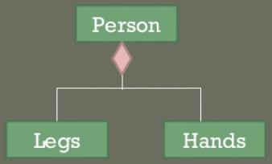

CLASS DIAGRAM
Aggregation
A relationship among instances of related classes - A specific kind of Container-Containee relationship.
A relationship where an instance of the Container-class has the responsibility to hold and maintain instances of each Containee-class that have been created outside the auspices of the Container-class.
Composition
A relationship among instances of related classes - A specific kind of Whole-Part relationship
A relationship where an instance of the Whole-class has the responsibility to create and initialize instances of each Part-class
Steering is part of car. At the same time steering has it’s own existence.
Menu is part of window. Menu exist only if windows exist. Once the window is closed the menu also get destructed.

Slide 11
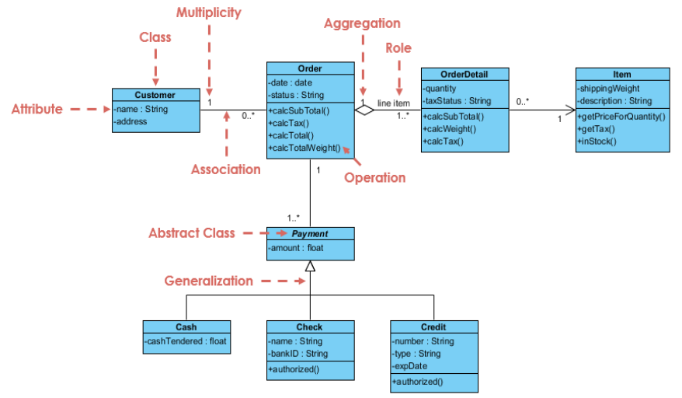
CLASS DIAGRAM
Class Diagram Example: Order System

Slide 12
Draw the class diagram for HMS

Slide 13
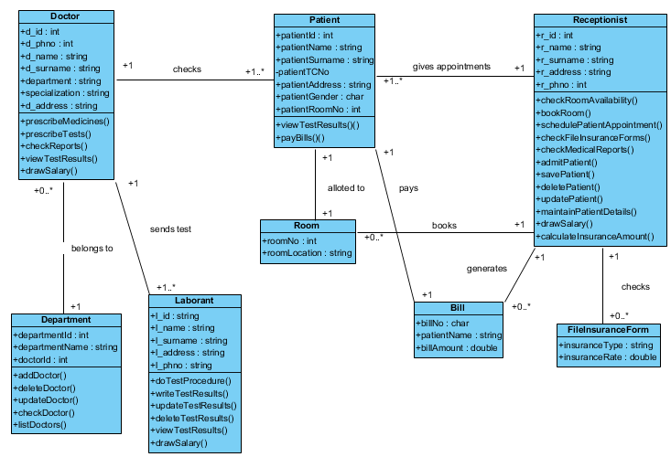
CLASS DIAGRAM FOR HMS

Slide 14
SEQUENCE DIAGRAM
The most common kind of Interaction Diagrams
shows how actors and objects interact to realize a use case scenario
focuses on the Message interchange between a number of Lifelines
You draw a sequence diagram if, e.g.:
you have a use case diagram, to describe how the main components of the system interact
you have identified messages arriving at an interface of a component, to describe how the internal parts of the component interact.

Slide 15
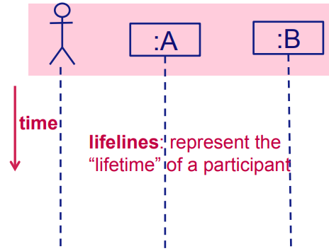
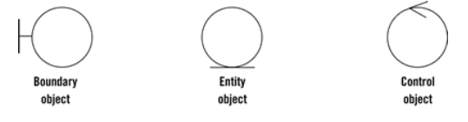
SEQUENCE DIAGRAM
Participants: actors, objects, etc. involved in the use case.
Kinds of participants:
• actor, class, database
• boundary, entity, control
Notation object:Class
• :Class = anObject:Class
Boundary objects interface with actors.
Entity objects represent system data, often from the domain.
Control objects glue boundary elements and entity elements, implementing the logic required to manage the various elements and their interactions.
!!! Not every system should have boundary/entity/control objects.

Slide 16
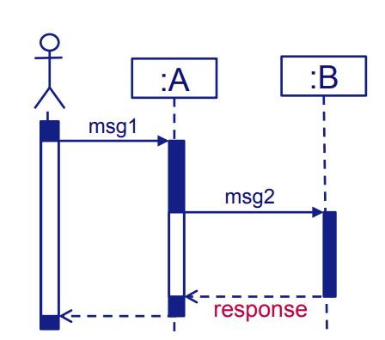
SEQUENCE DIAGRAM
Order of participants = order of the first participation in the interaction
Most of the message sends on arrows from left to right
Intuition: Messages are sent to objects of classes with the corresponding operations.
• Class A has method msg1
• Class B has method msg2
When a message is received by an object, a new activation is started.
Activation is also known as execution specification.
activation
response

Slide 17
Draw the sequence diagram for HMS

Slide 18
SEQUENCE DIAGRAM FOR HMS
You can draw a sequence diagram if you have a use case diagram

Slide 19
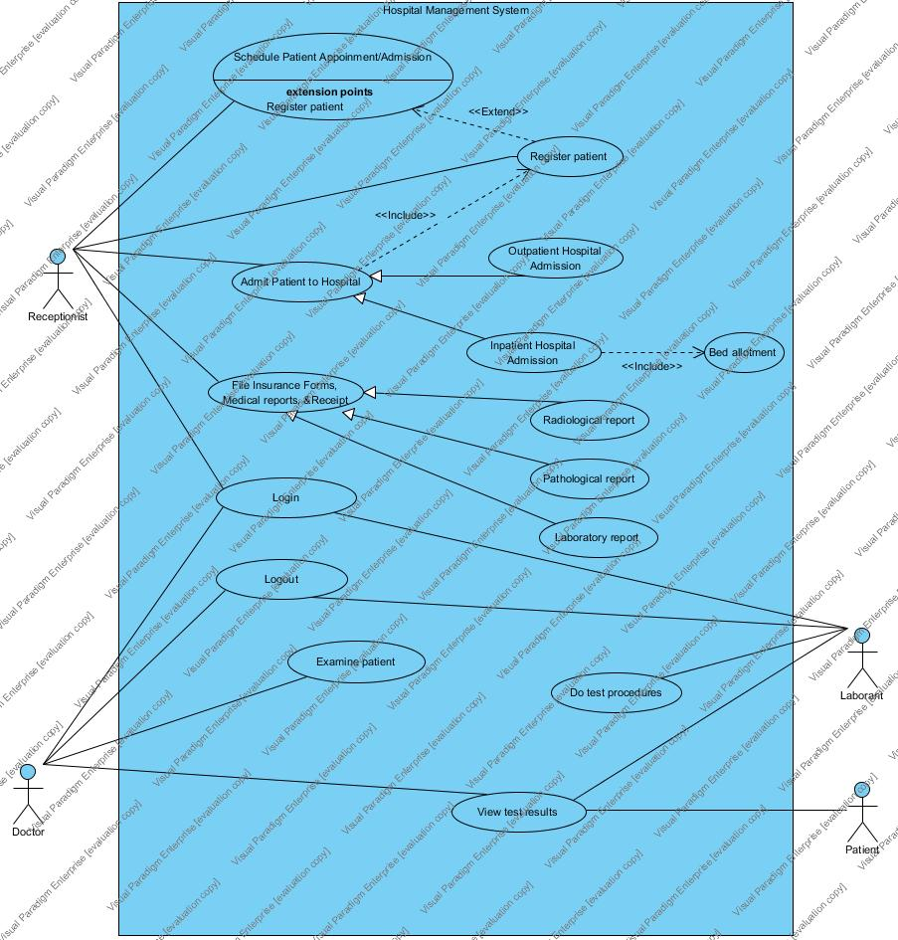
USE CASE DIAGRAM OF THE HOSPITAL MANAGEMENT SYSTEM

Slide 20
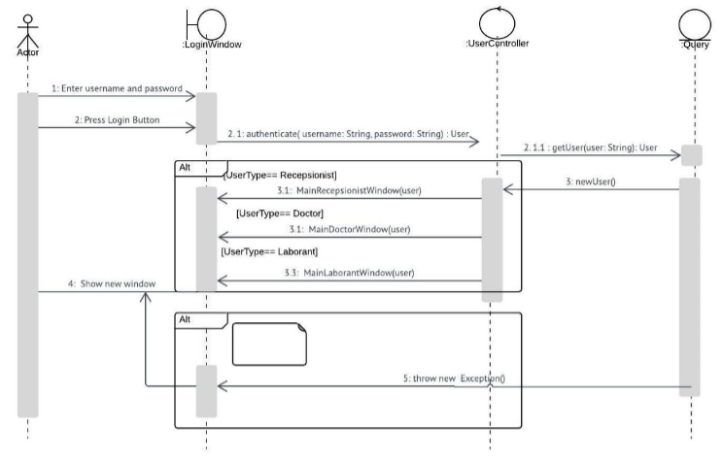
Sequence Diagram for Login Use-Case

Slide 21
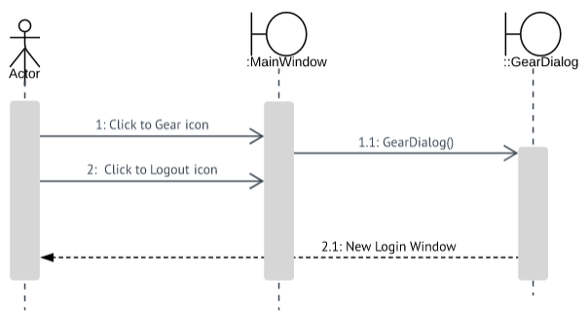
Sequence Diagram for Logout Use-Case

Slide 22
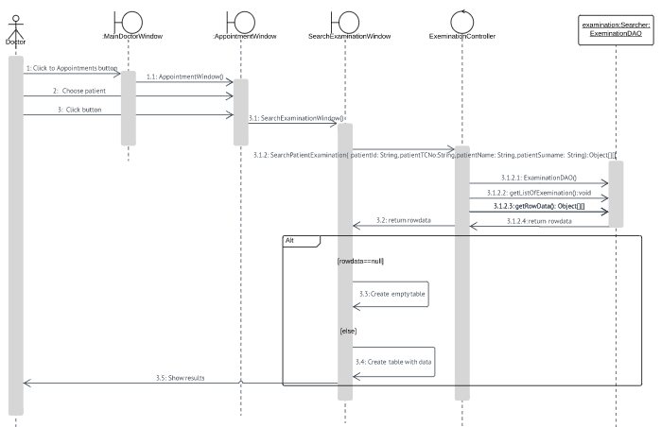
Sequence Diagram for Examine Patient Use-Case

